Slide 1
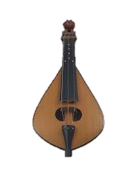
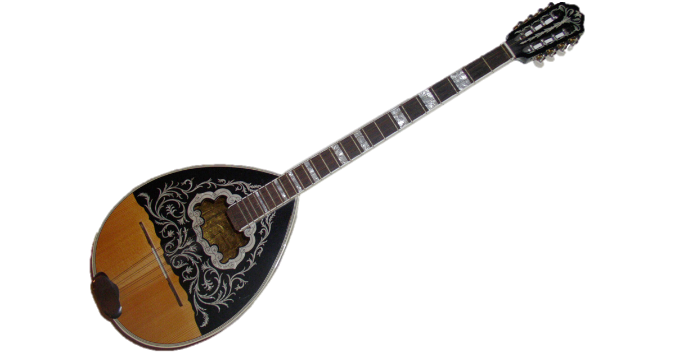


Harmonies of Heritage
Classification of Greek Traditional
& Folk Music by Region
Foukanelis Christos (mtn2324)
Vytiniotis Konstantinos (mtn2308)
DEMOKRITOS
NATIONAL CENTRE FOR SCIENTIFIC RESEARCH

Slide 2
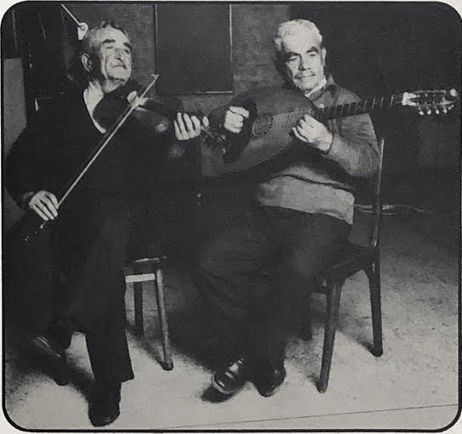
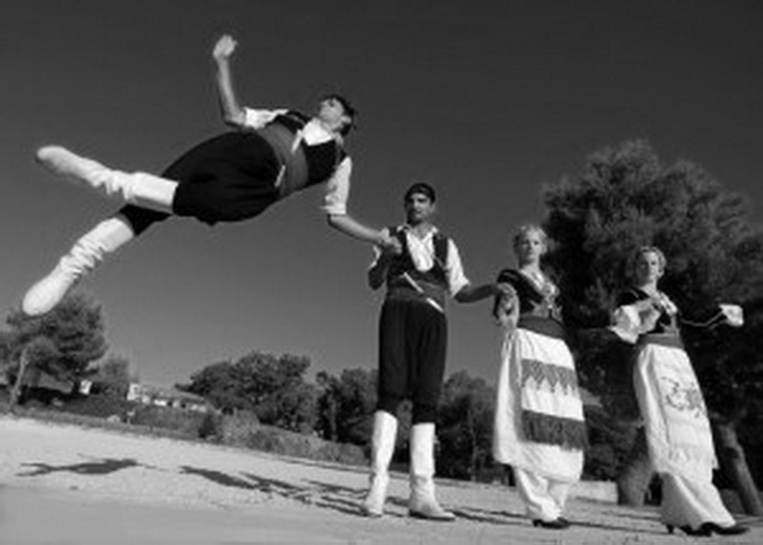
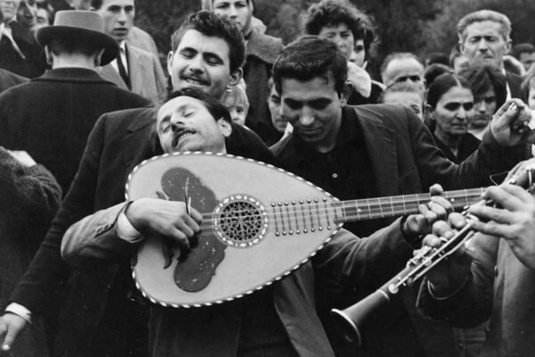
Agenda
Problem Statement
Dataset Overview
Feature Extraction
Baseline
CNN Approach
Sequential Approach
Comparative Analysis
Conclusions

Slide 3
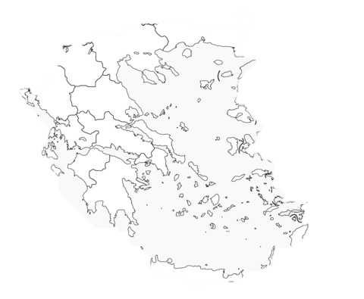
Problem Statement
Problem
Audio Classification
Classify Greek traditional & folk songs according to their region of origin
Use Deep Learning architectures to achieve classification task
Aims to facilitate and streamline the process of preservation and logging of Greek Traditional songs

Slide 4

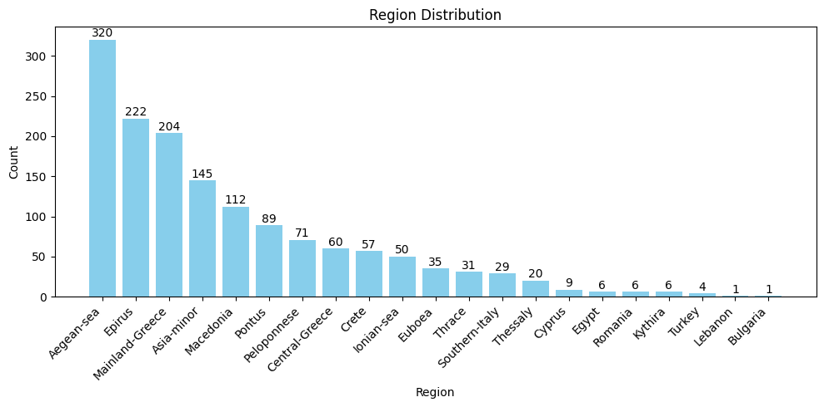
Dataset Overview
Lyra Dataset
Main data source
Enhanced with manual data collection and annotations (30%)
Each class represents a group of sub-regions with common cultural characteristics
Grouped together to 19 classes that cover the majority of geographical regions
Audio are coming from live recordings
Source: The Lyra Dataset

Slide 5


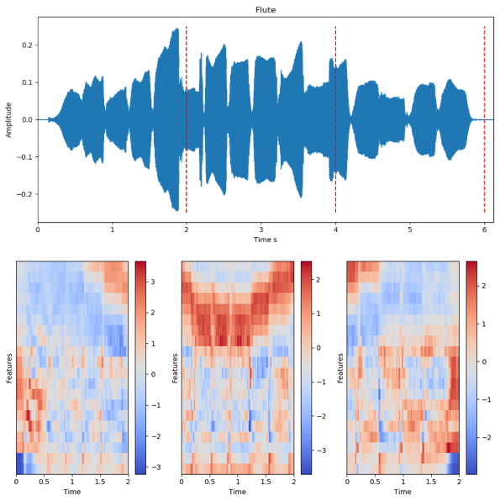
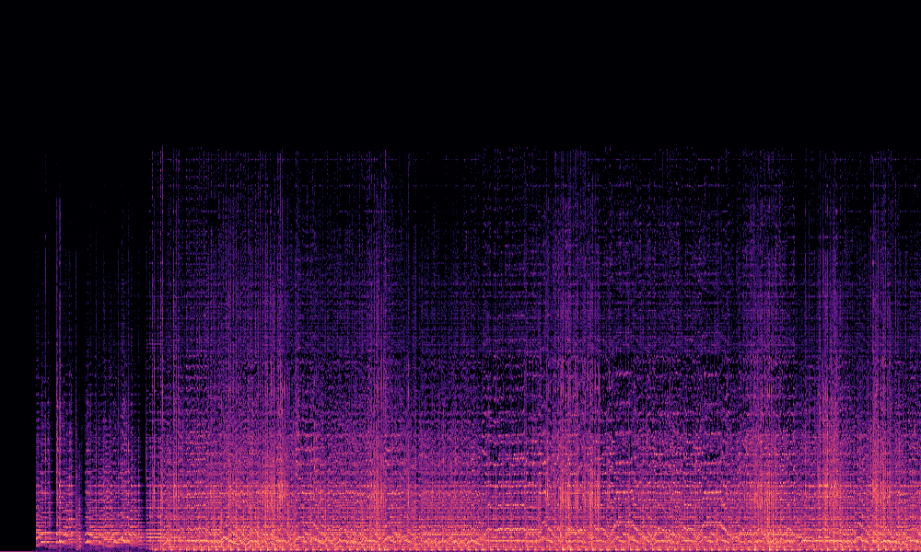
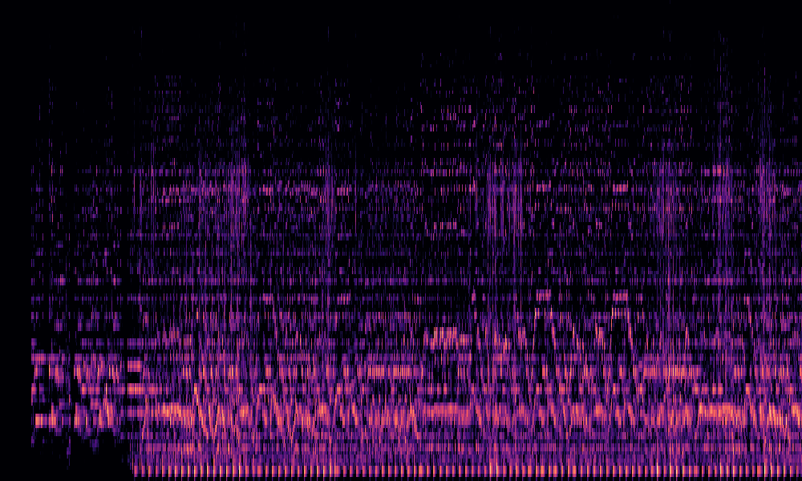
Feature Extraction
Extract of 138 features per audio file
Included mean/std per feature
Features
MFCCs
Chroma
Spectral
ZCR
Librosa
Timeseries RAW audio samples segmented into frames (sampling rate 44,1 kHz)
Calculated per window of a couple ms, averaged per segment
Spectrograms
Mel-Spectrograms

Slide 6
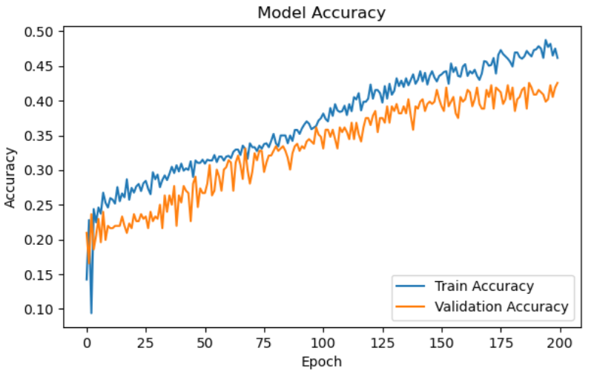
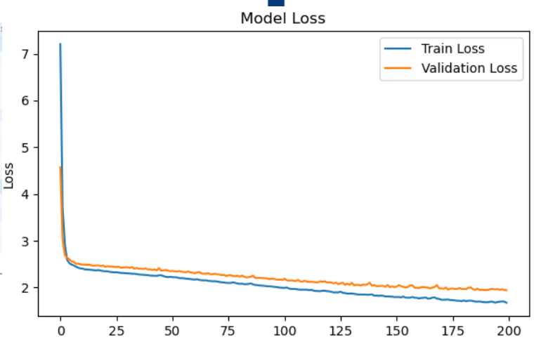
Baseline
SVM
FFNN
Parameters
C: 1000
Gamma: 0.01
Kernel: RBF
Parameters
Epochs: 200
Batch Size: 100

Slide 7
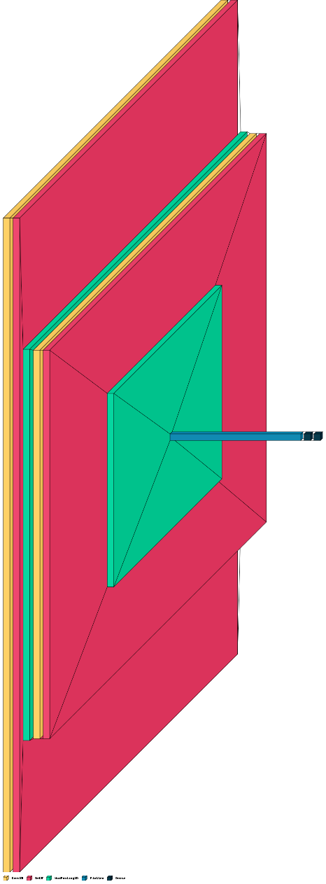
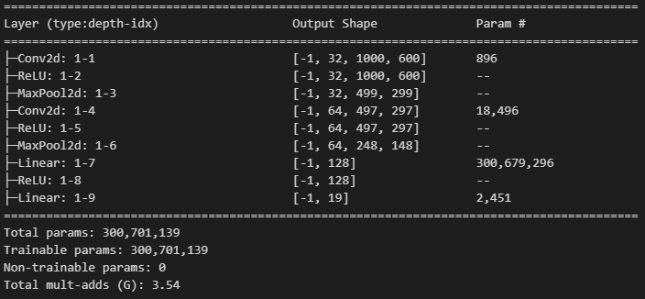
CNN Approach – Part 1
With Mel-Spectrogram Feed
With Spectrogram Feed

Slide 8
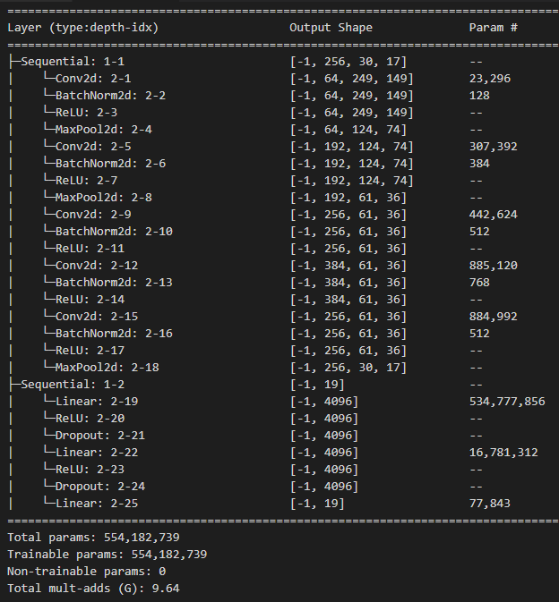
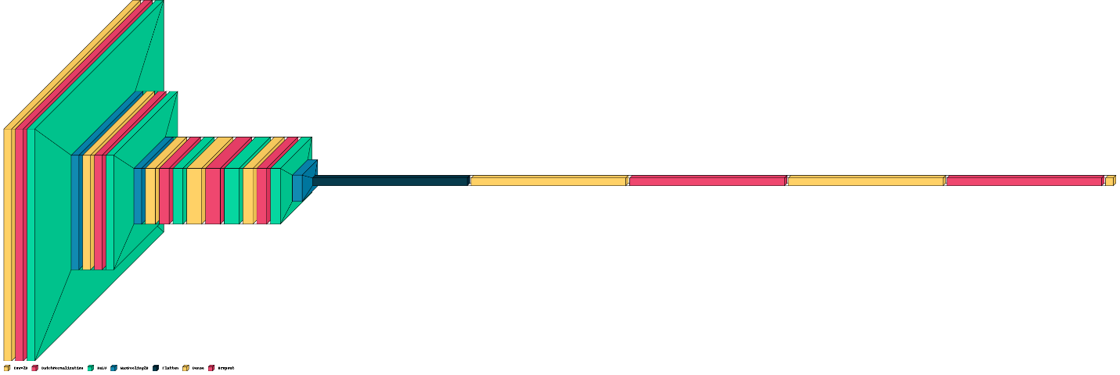
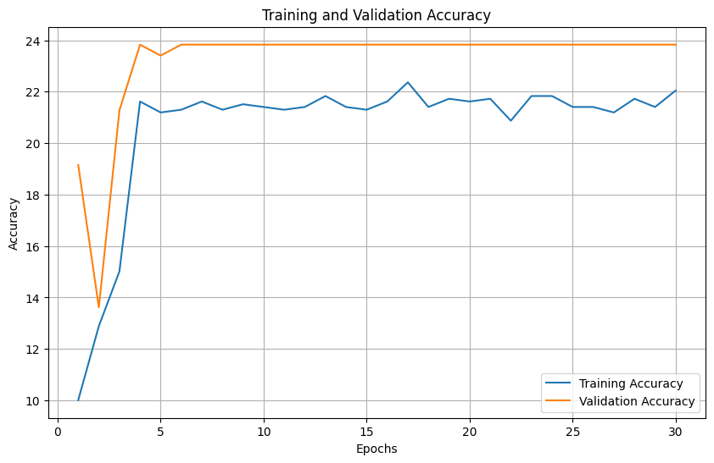
CNN Approach – Part 2
With Spectrogram Feed
With Mel-Spectrogram Feed

Slide 9
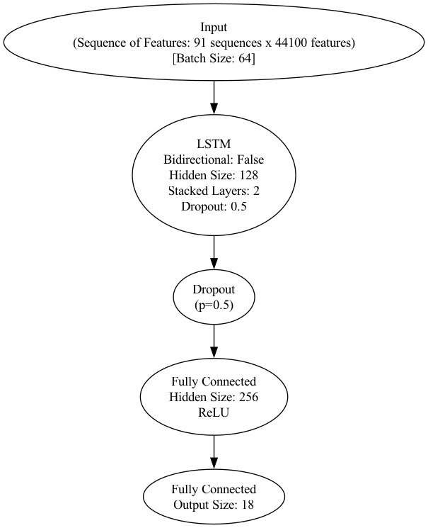
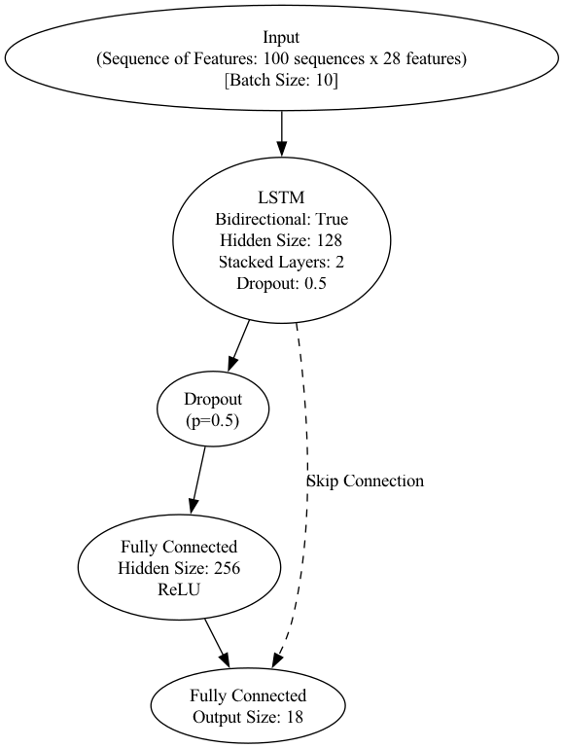
Sequential Approach – Part 1
High-Level Overview
Sequential nature
Sequences of raw samples/ features were imported
Performance not as expected
Underfitting
Computationally complex
RNN – RAW DATA
RNN – FEATURE DATA

Slide 10
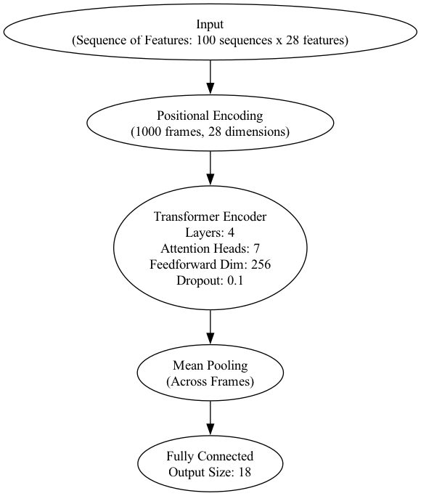
Sequential Approach – Part 2
High-Level Overview
Attention can capture more long term complex features
Improved Performance
Positional Encoding to capture position context
7 multi-head Attention heads for learning diverse patterns
Parallelization
TRANSFORMER - FEATURE DATA

Slide 11
Comparative Analysis
Key Takeaways
Best performance: SVM & Transformer
CNN – FFNN runner-up
Worst performance: RNN
Complex models require more data
Architecture | SVM (feat) | FFNN (feat) | CNN (Spec) | CNN (Mel) | RNN (raw) | RNN (feat) | Transformer (feat)
Accuracy | 0.38 | 0.23 | 0.17 | 0.33 | 0.04 | 0.22 | 0.34
Avg Train Time | 23s | 110s | ~1h | ~1h | ~2h | ~10m | ~5m

Slide 12
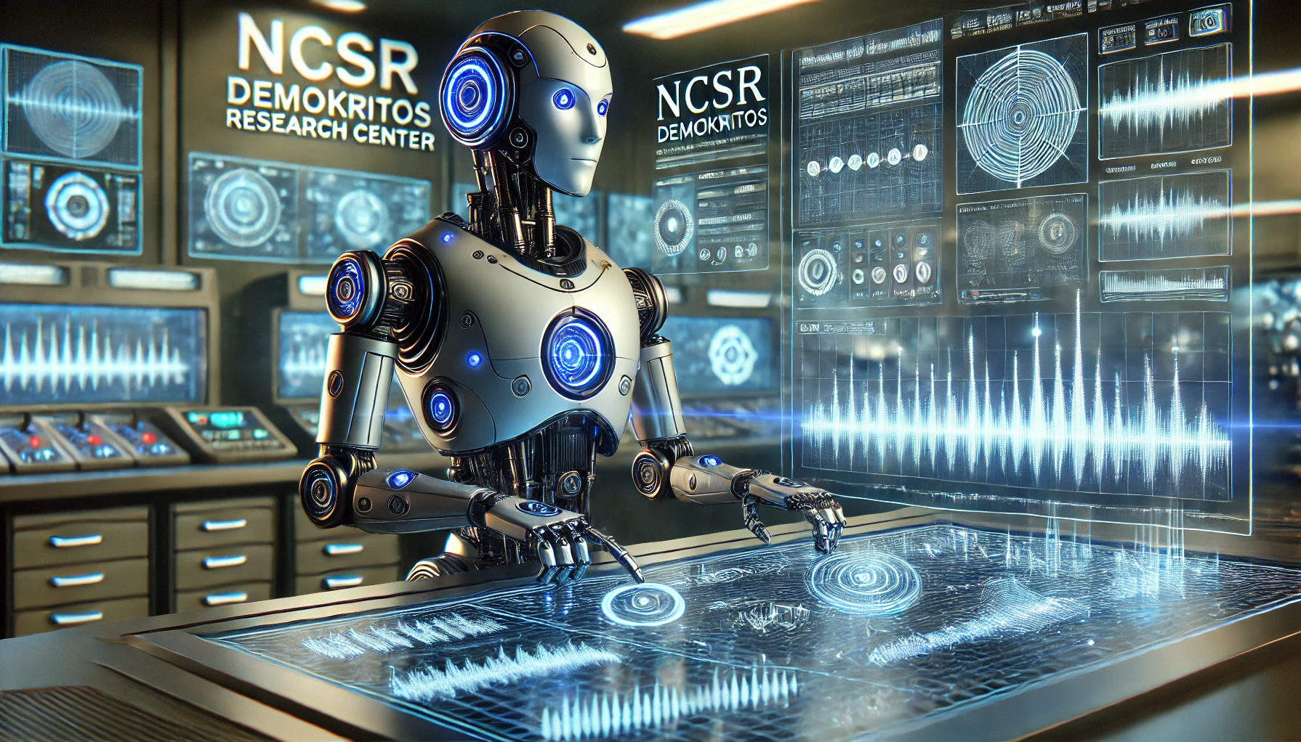
Conclusions
Conclusions
Different Methods Tested
CNN and Transformers had promising
Challenges
Imbalanced classes with few training samples
Noise in data
Hard to separate audio features (musical genre similarities)
Improvements
Noise reduction before training
Data augmentation
Class balancing
Fine tune pretrained models
Hybrid models

Slide 13

Q & A
Thank You!

